Slide 1
Lecture 26: Visitor Design Pattern

Slide 2
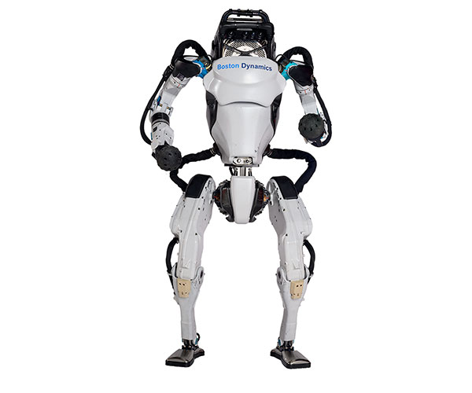
public void on();
public void walk();
public void bendKnees();
public void jump();
public void sit();
public void sideRoll();
public void frontRoll();
public void run();
public void off();
https://robots.ieee.org/robots/atlas2016/
https://www.youtube.com/watch?v=WcbGRBPkrps
Can’t jump while running.

Slide 3
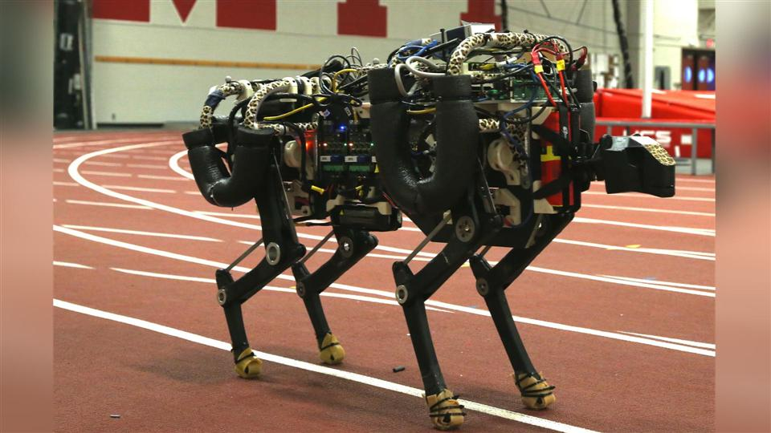
https://www.youtube.com/watch?v=_luhn7TLfWU
public void on();
public void walk();
public void bendKnees();
public void jump();
public void jumpWhileRunning();
public void sit();
public void sideRoll();
public void frontRoll();
public void run();
public void off();
It can jump while running!

Slide 4
Visitor Pattern
Visitor design pattern is one of the behavioral design pattern.
Visitor lets us define a new operation without changing the classes of the elements on which it operates.
It is also very useful when we have to perform an operation on a group of similar kind of Objects.
With the help of visitor pattern, we can move the operational logic from the objects to another class.

Slide 5
The visitor pattern consists of two parts:
a method called Visit() which is implemented by the visitor and is called for every visitable objects
visitable classes providing Accept() methods that accept a visitor
Visitor
<interface>
Visitable
<interface>
+ visit (Liquor): double
+ visit (Tobacco): double
+ visit (Necessity): double
+ accept (Visitor): double
Liquor
Necessity
+ accept (Visitor): double
+ accept (Visitor): double
TaxVisitor
+ visit (Liquor): double
+ visit (Tobacco): double
+ visit (Necessity): double

Slide 6
Demonstration

Slide 7
Next Lecture
Drag and Drop (DnD)

